Slide 1
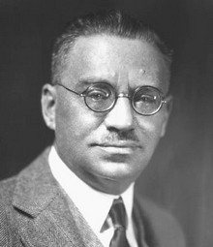
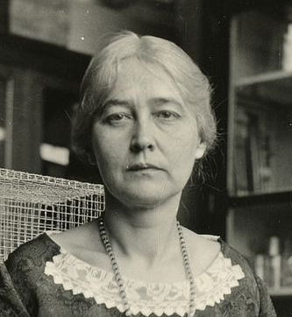
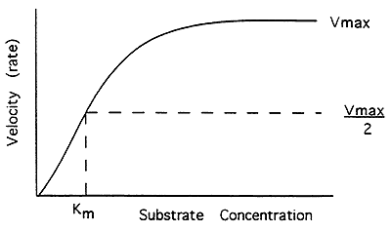
MCB 135 Lecture 6 Enzyme Kinetics
Notes:
Walter Pitts, John von Neumann

Slide 2
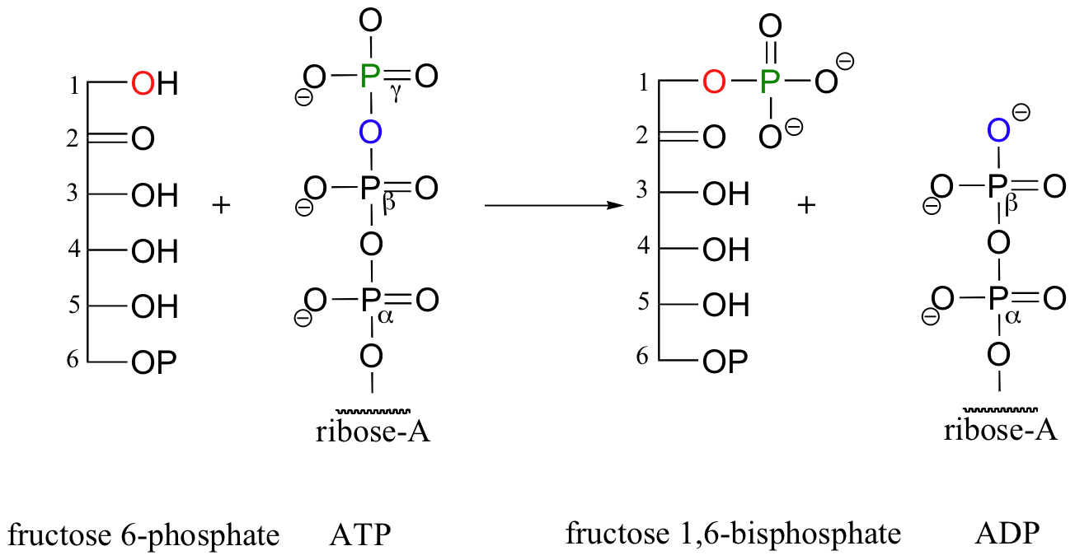
Recap: moiety conservation restricts how concentrations change together
[F6P] + [F1,6BP] = constant
[ATP] + [F1,6BP] = constant
[ATP] + [ADP] = constant

Slide 3
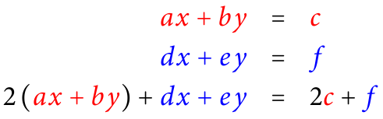
Follow-up: systematic method for identifying moieties
General principle: if a set of equations are all true, then any linear combination of them is also true

Slide 4
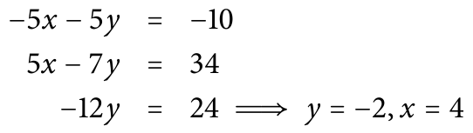
Follow-up: systematic method for identifying moieties
You may have employed this technique to solve systems of equations in an algebra course.

Slide 5
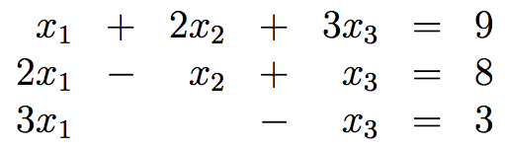
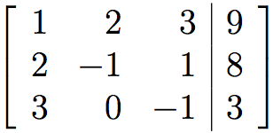
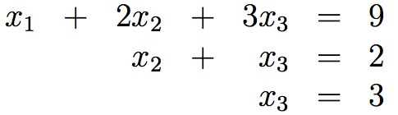
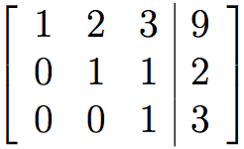
Follow-up: systematic method for identifying moieties
In matrix form, this technique is called
Gauss-Jordan elimination.

Slide 6
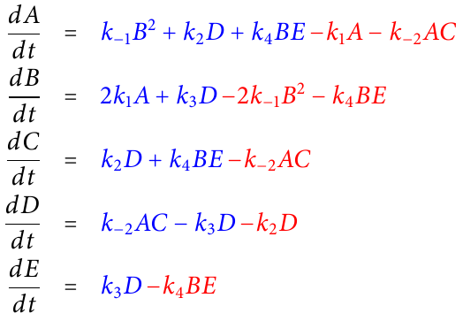
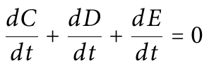
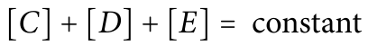
Follow-up: systematic method for identifying moieties
If we could find a linear combination of ODEs that sums to zero, e.g.
then integration w.r.t. time would give us a conservation rule:
Notes:
You don’t need to confirm visually that this is true.
How do we find the appropriate combinations?

Slide 7
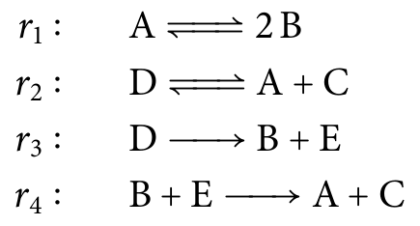
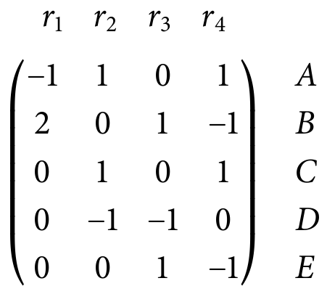
Follow-up: systematic method for identifying moieties
Step one: number the reactions
k₁
A
2B
k₋₁
Step two: construct a stoichiometry matrix
k₂
D
A + C
k₋₂
k₃
k₄
B + E

Slide 8
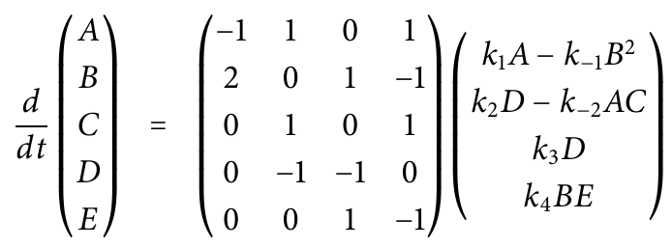
Follow-up: systematic method for identifying moieties
Step three: express the rates of change for each molecular species using the stoichiometry matrix
Found last time using
the law of mass action
Rewritten in matrix form
Notes:
Because we are dealing with net forward reaction rates, we will see that it is not necessary to include the reverse reactions with a separate name. (Irreversibility imposes that v3 and v4 are non-negative, but this as it turns out will not be the focus of our attention.)

Slide 9
Follow-up: systematic method for identifying moieties
Step three: express the rates of change for each molecular species using the stoichiometry matrix
Notice that these are the
“net forward reaction rates”
(we’ll call them v_{i})
Found last time using
the law of mass action
Rewritten in matrix form
Notes:
Because we are dealing with net forward reaction rates, we will see that it is not necessary to include the reverse reactions with a separate name. (Irreversibility imposes that v3 and v4 are non-negative, but this as it turns out will not be the focus of our attention.)

Slide 10
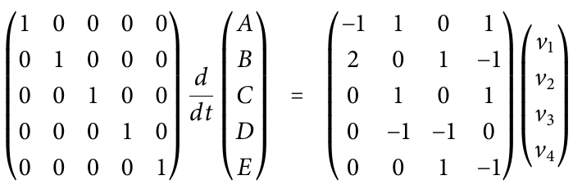
Follow-up: systematic method for identifying moieties
Rewrite in an equivalent form:

Slide 11
Follow-up: systematic method for identifying moieties
Our goal: apply row reduction (aka Gaussian elimination) so that some rows of the stoichiometry matrix become all zeros.
Then, the left-hand side will tell us that some combination of the derivatives sums to zero.

Slide 12
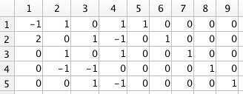
Follow-up: systematic method for identifying moieties
Input the stoichiometry matrix
(augmented by the identity matrix)
into MATLAB
Notes:
Row reduction can be done by hand (see the posted PDF under lecture 5 if you are curious) but in practice it is easiest to

Slide 13
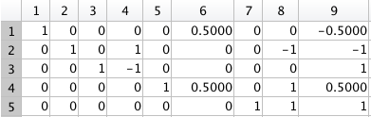
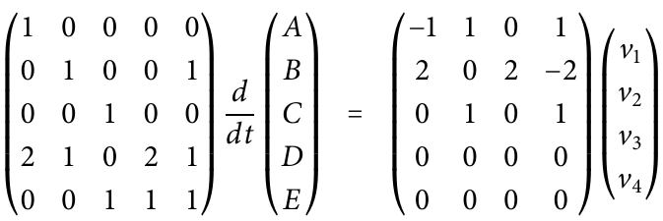
Follow-up: systematic method for identifying moieties
Input the stoichiometry matrix
(augmented by the identity matrix)
into MATLAB
Call the rref() function
Notes:
Row reduction can be done by hand (see the posted PDF under lecture 5 if you are curious) but in practice it is easiest to

Slide 14
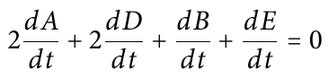
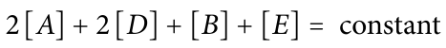
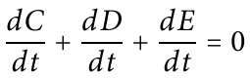
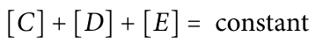
Follow-up: systematic method for identifying moieties
These are our two conserved moieties
Notes:
Row reduction can be done by hand (see the posted PDF under lecture 5 if you are curious) but in practice it is easiest to

Slide 15
Today’s Outline
Rate of product formation in enzyme catalysis
Recap of simplifying assumptions and enzyme catalysis
Michaelis-Menten kinetics
Simple binding curves
Hyperbolic form
The switch-like behavior problem
Hemoglobin as a natural example of a sigmoidal form

Slide 16
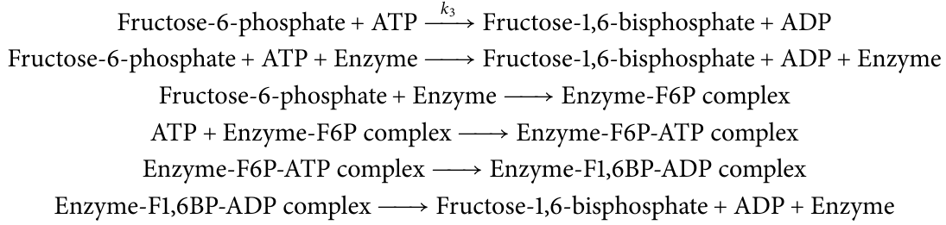
Enzyme catalysis is a composite reaction
When catalyzed by the enzyme phosphofructokinase, this reaction has several steps:
Notes:
We saw last Monday

Slide 17
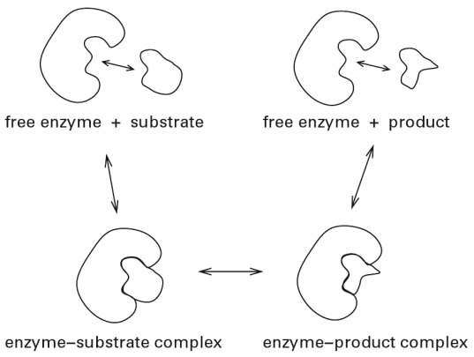
Enzyme catalysis is a composite reaction
Notes:
Emphasize that E is the free, not total, concentration of enzyme. Some of the enzyme might be bound to substrate and product as well.

Slide 18
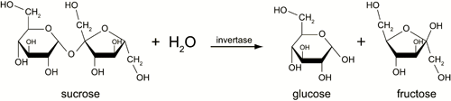
Reducing the model’s complexity
Leonor Michaelis
Maud Menten
Notes:
Sucrose is table sugar and is dextrorotary; fructose is strongly levorotary, glucose only modestly dextrorotary.

Slide 19
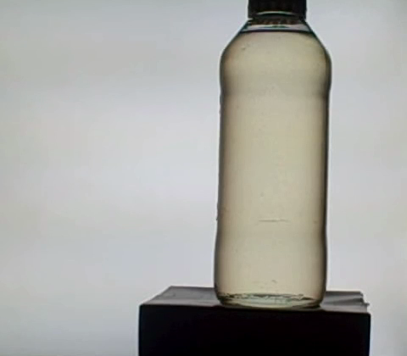
Reducing the model’s complexity
Notes:
When the background light is totally obscured by the second polarization filter, some light that passed through the syrup is still getting through because it was rotated by the sugars inside.

Slide 20
Recap: common simplifying assumptions
A chemical’s concentration has a particular constant value
A chemical’s concentration is at steady-state
The “quasi-steady-state” assumption
Can find an expression for the steady-state concentration from the chemical’s ODE
A particular reversible reaction has reached equilibrium
The “rapid equilibrium” assumption

Slide 21
Simplifying the enzyme catalysis model
Assume this interconversion is very fast
(rapid equilibrium assumption)
Without enzyme
‡
ΔG = - RT ln k_{f}
With
enzyme
Gibbs Free Energy, G
Substrate(s)
Products
“Reaction progress”
Notes:
Ask audience why is rapid equilibrium assumption appropriate for this interconversion.

Slide 22
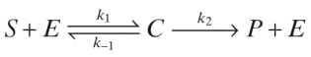
Simplifying the enzyme catalysis model
Assume this reaction is effectively irreversible
Assume this interconversion is very fast
(rapid equilibrium assumption)
Our simplified model:
Catalytic constant
(also denoted k_{cat})
Notes:
Ask audience why is rapid equilibrium assumption appropriate for this interconversion.

Slide 23
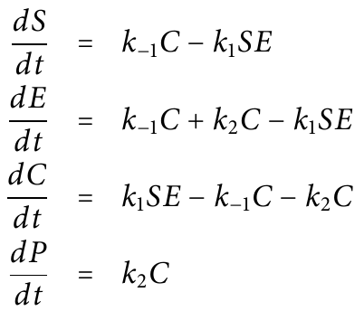
How are these species’ concentrations changing with time?

Slide 24
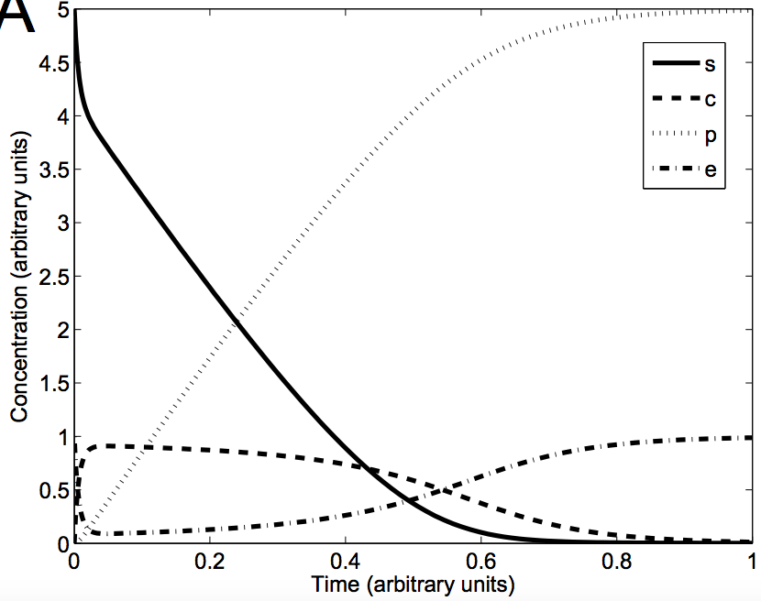
How are these species’ concentrations changing with time?
Fast timescale:
[C] rises to a
quasi-steady-state
Slow timescale:
S converts to P
Notes:
Discuss the long-term behavior first

Slide 25
Why does the fast timescale exist?
k₁, k₋₁ >> k₂
[S] >> [E], [C]

Slide 26
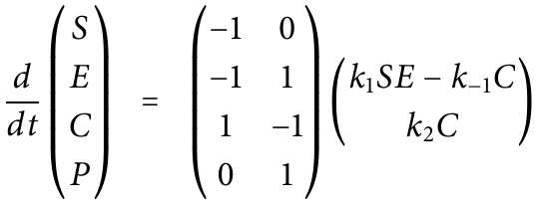
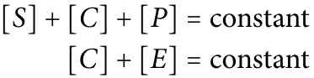
Simplifying the model using moiety conservation
Rewrite using a stoichiometry matrix:
Perform row reduction, and find:
Notes:
Discuss the physical interpretation of these moieties.

Slide 27
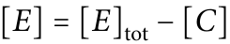
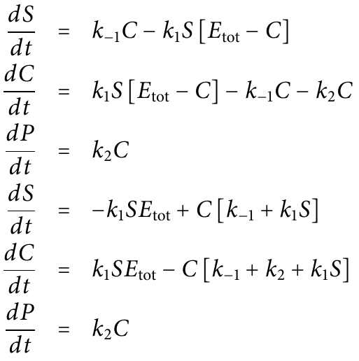
Simplifying the model using moiety conservation

Slide 28
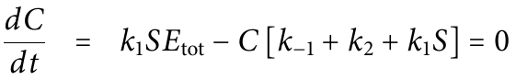
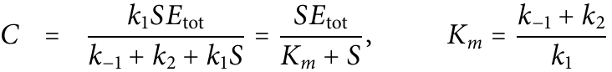
Exploiting the rapid approach of [C] to quasi-steady-state
Notes:
Quasi-steady-state assumption

Slide 29
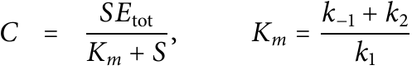
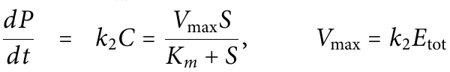
How fast is the product forming?
The Michaelis-Menten equation

Slide 30
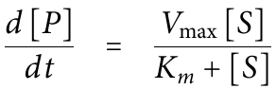
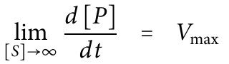
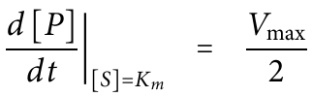
The physical interpretation of K_{m} and V_{max}
Notes:
Note that this is a hyperbolic function

Slide 31
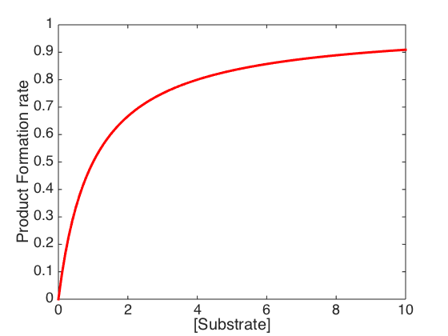
Approximations at two extremes
High [S]:
Rate ≈ V_{max}
Low [S]:
Rate ≈ V_{max}[S]/K_{m}

Slide 32
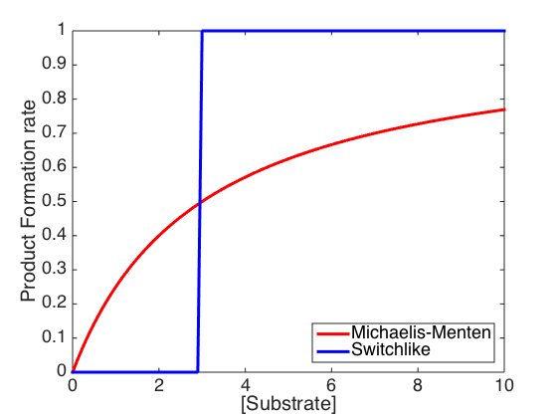
Hyperbolic, not switch-like, behavior
Notes:
Km = 3

Slide 33
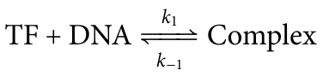
Not all biological reactions are enzyme-catalyzed
Transcription
factor
Regulated gene

Slide 34
Not all biological reactions are enzyme-catalyzed
?
Fraction of DNA bound at equilibrium
[TF]

Slide 35
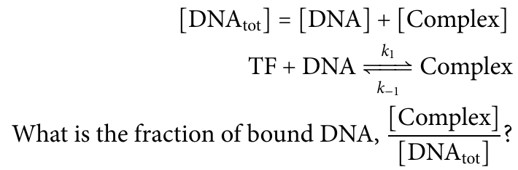
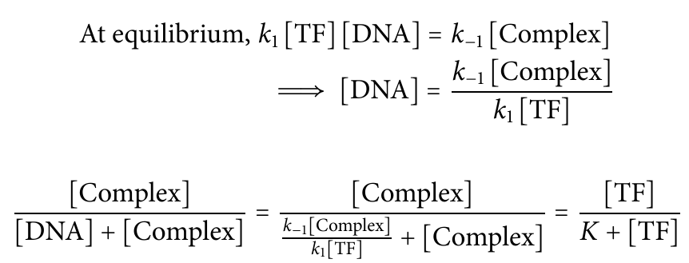

Slide 36
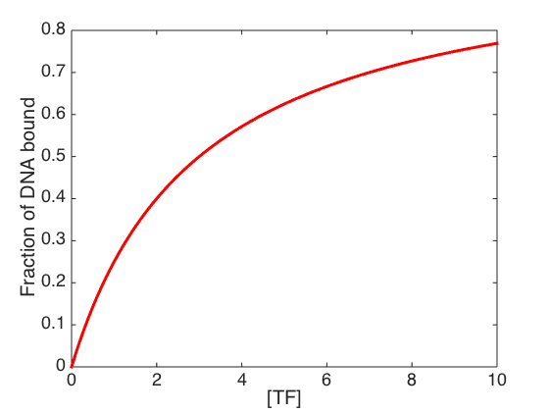
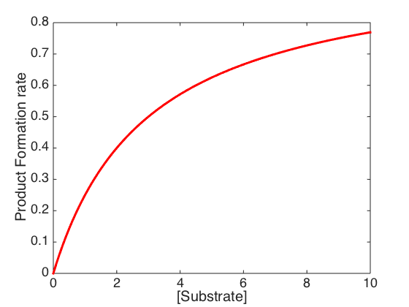
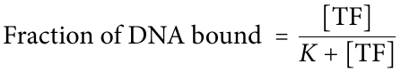

Simple binding curves have the same form as Michaelis-Menten curves

Slide 37
Organisms follow algorithms to determine responses to “inputs” from their environments
Are these computations are inherently limited?
A system can compute anything if it can implement Boolean logic and memory (Church-Turing thesis)
Boolean logic requires all-or-none responses to binary inputs
→ Want to show that all living systems can implement Boolean variables
Notes:
Church-Turing hypothesis

Slide 38
How can organisms make switch-like responses with binding/enzyme kinetics?
Notes:
Reminder that in the first week, we saw that if a system can implement Boolean logic, then it can be programmed to perform any algorithm. In fact, it would be as powerful as any general computer.
In fact,
the case of livi
Boolean logic, then it can be made to respond logically
It will be easier to start with the binding case

Slide 39


Oxygen transport
A few cells thick: diffusion suffices
Much larger:
circulatory and respiratory systems needed
Notes:
If you’re a couple of cells thick, like a jellyfish, you can rely on oxygen to diffuse

Slide 40
Oxygen loading in the lungs can limit oxygen transport
That’s all?
RBC
Notes:
Even with a circulatory system, flow can be limited by shallow concentration gradients.
A shallow gradient is bad in two ways. First, few oxygen molecules will enter the red blood cell and certainly the concentration will be no higher than it was in the lungs. Secondly, the flow of oxygen into the red blood cell will slow down as the RBC approaches equilibrium with the high-oxygen fluid in the lungs. A shallow gradient means the rate of oxygen loading is potentially slow.

Slide 41
By forming complexes, oxygen-binding proteins can “hide” oxygen inside the red blood cell
RBC
Notes:
Even with a circulatory system, flow can be limited by shallow concentration gradients.
A shallow gradient is bad in two ways. First, few oxygen molecules will enter the red blood cell and certainly the concentration will be no higher than it was in the lungs. Secondly, the flow of oxygen into the red blood cell will slow down as the RBC approaches equilibrium with the high-oxygen fluid in the lungs. A shallow gradient means the rate of oxygen loading is potentially slow.

Slide 42


Ideal properties for an oxygen-binding protein
Oxygen bound
ppO₂
In the lungs, where ppO₂ is high, binds as much oxygen as possible
In other tissues, where ppO₂ is low, releases as much oxygen as possible

Slide 43


The protein hemoglobin has four subunits, each cradling a heme group
~ 4 nm
PDB May 2003 Molecule of the Month

Slide 44

Heme’s absorption spectrum changes on oxygen binding
Superoxide (O₂⁻)
Fe²⁺
Fe³⁺
Dark red
Bright red
Stryer Fig. 7.2
Notes:
Heme does not float freely in blood. It is held in place by amino acids in a protein called hemoglobin, so that it has a fifth ligand (the amino acid histidine). When it binds oxygen, it gets a sixth ligand and changes to an octahedral geometry. The iron “donates” an electron to bound oxygen gas and therefore changes oxidation state. Both of these changes are expected to alter the spacing of the molecular orbitals and therefore, we would predict, change the spectrum of light absorbed.

Slide 45


The fraction of hemoglobin bound by oxygen can be estimated from the absorption spectrum
Courtesy of Scott Prahl
Notes:
Many studies

Slide 46

The fraction of hemoglobin bound by oxygen can be estimated from the absorption spectrum
Courtesy of Scott Prahl
Liu et al., 2012
Notes:
Many studies

Slide 47

The fraction of hemoglobin bound by oxygen can be estimated from the absorption spectrum
Liu et al., 2012
Notes:
Even gets as bad as 20 mm Hg in exercising tissue so oxygen is really being dumped where it’s needed. 100 mm Hg ~ 15 kPa.

Slide 48

Hemoglobin has a sigmoidal, not hyperbolic, binding curve
Notes:
Even gets as bad as 20 mm Hg in exercising tissue so oxygen is really being dumped where it’s needed. 100 mm Hg ~ 15 kPa.

Slide 49
Next time: Cooperativity and inhibition

